Slide 1
A1 TEAM
TEAM MEMBERS:
1. SUDHEER REDDY S (TEAM LEAD)
2. ABHISHEK HAZARI
3. MARUTHI AUSALI
4. LIKHITHA G
5. ANJALI B
6. SANDHYA S

Slide 2
SOLDIER’S STRAP

Slide 3
PROBLEM STATEMENT
The Nations security plays a vital role in forming a terror free country. It is monitored especially by Indian Armed Forces. Soldier’s are the backbone of Indian Armed Forces and they struggle a lot to serve selflessly for the Nation. Unfortunately “Soldier’s loose their lives due to lack of medical help”.

Slide 4
SOLUTION
Soldiers loose their lives due to lack of medical health in Warfield's. So to over come such problems a soldier strap is being designed with the following functionalities:
It locates the exact position of soldier using GPS tracker
It sends messages to the concerned authorities using GSM modem.
It monitors and records the body parameters using pulse or heartbeat sensor and also temperature sensor.
It provide sufficient battery life using lithium ion battery and also solar energy according to respective weather conditions.

Slide 5
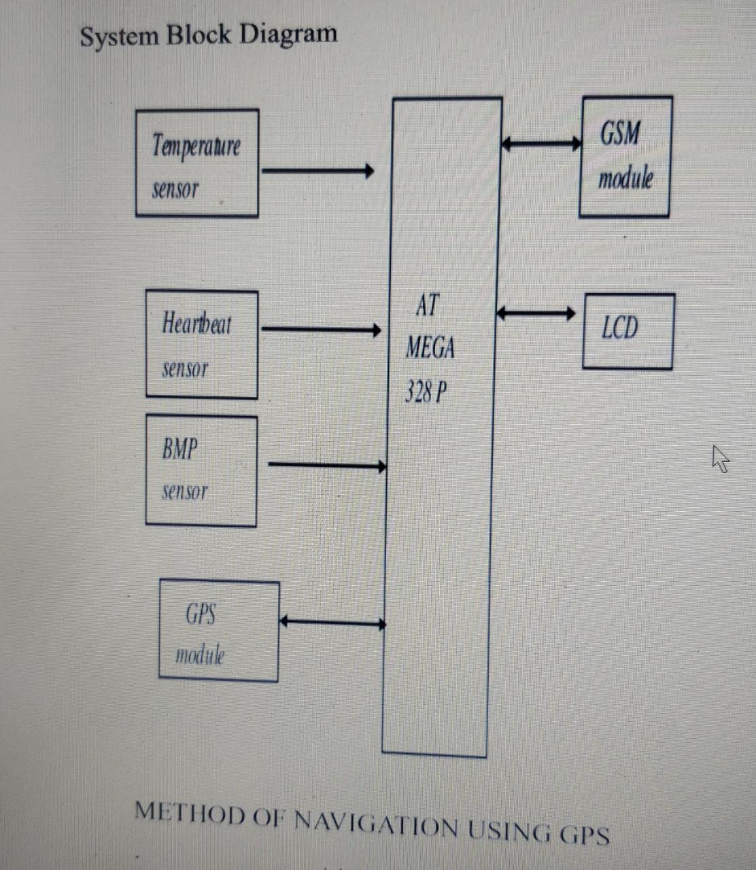
METHODOLOGY

Slide 6
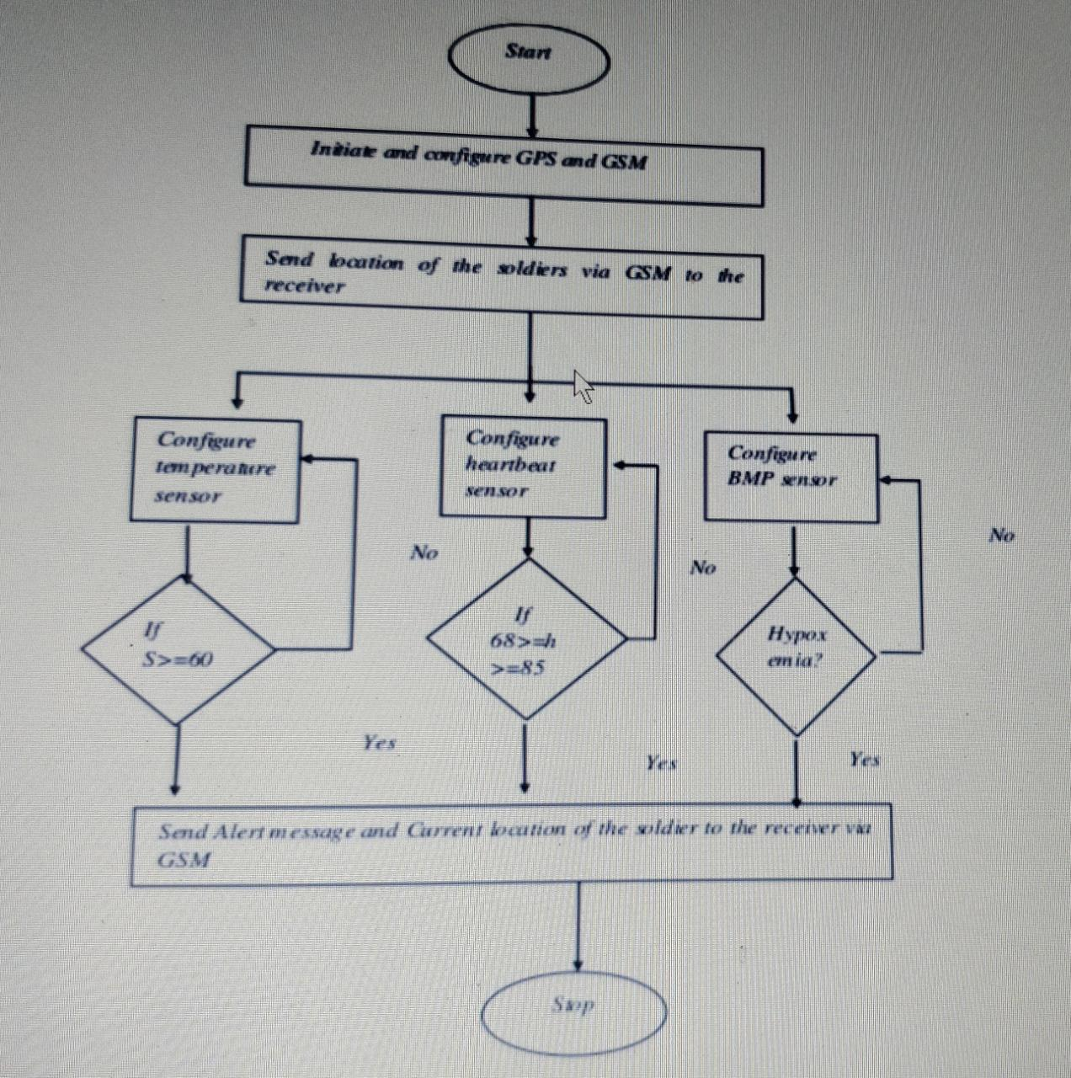
FLOWCHART

Slide 7
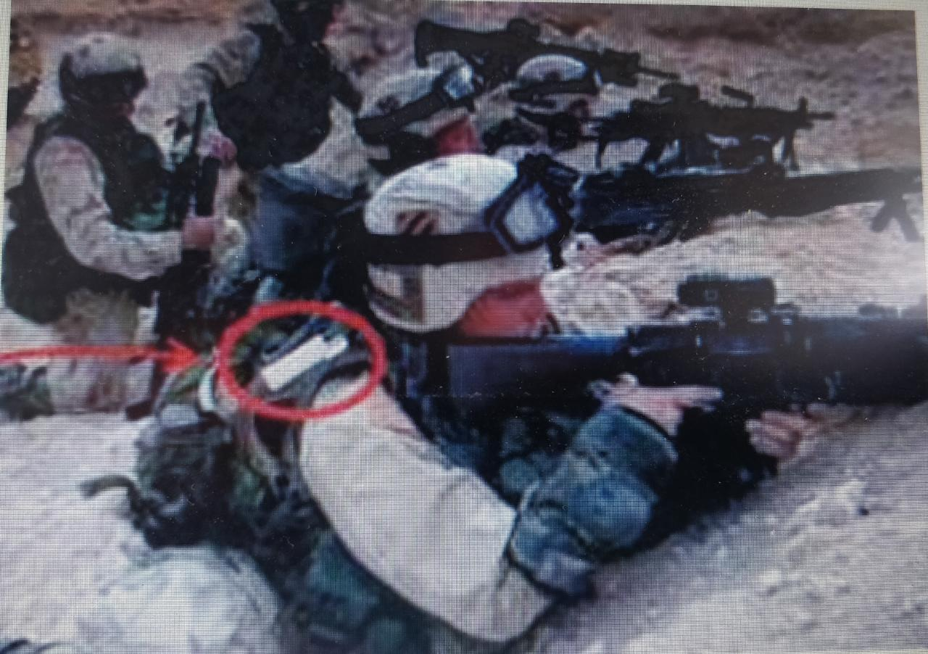

Slide 8
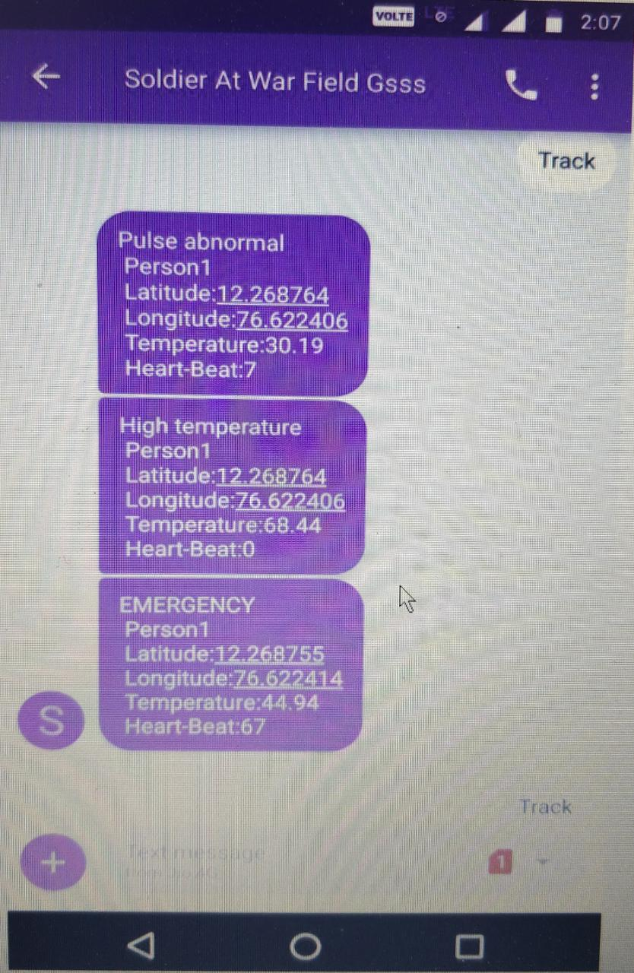

Slide 9
CONCLUSION
Hence we conclude that by designing this device “Soldier’s Trap” we can overcome the major problems being faced by the soldier’s in Warfield's due to Non-availability of required resources i.e., medical help.

Slide 10
THANKYOU

